Slide 1
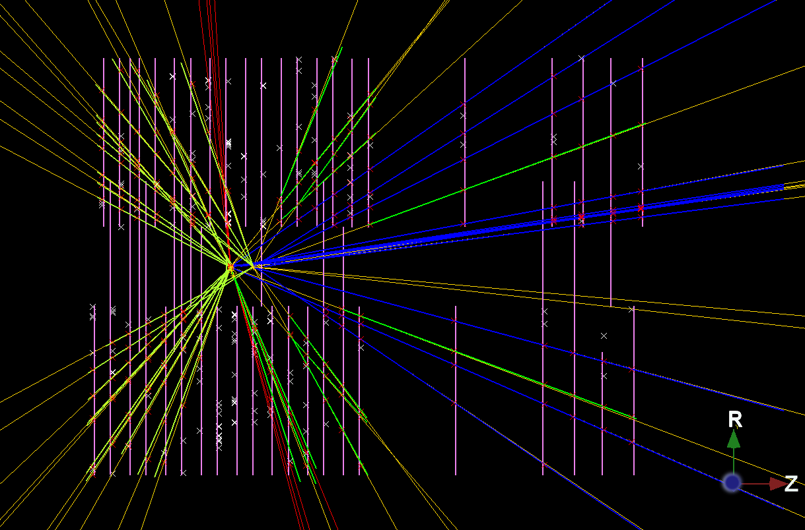

NIKHEF
Using Python In LHCb
E. Rodrigues, NIKHEF
A Practical Introduction

Slide 2
Disclaimer
What this tutorial is not
A course on Python
A course on GaudiPython
A technical presentation
What this tutorial is
An incentive to start exploiting Python in our everyday work
A presentation a la “learning by examples”
An informal tutorial
We will have a session devoted to Python at the LHCb Software Week on the
20th … with a more technical flavour …

Slide 3
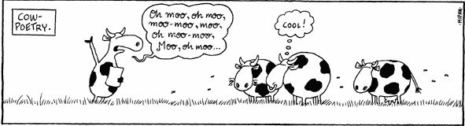
Why should I use Python?
What is Python?
OO scripting language
Interpreted – no compilation needed
Dynamically typed
Why should I use it?
Very easy to use, powerful, elegant
Fast learning curve
Extensive set of modules available on market
Ideal for interactive work/analysis, testing, prototyping new ideas, …
Allows to work with different applications at the same time
    e.g.: Gaudi + ROOT
Not convinced yet? Relax, wait and see … ;-)
Before …
… and after

Slide 4
Basics of using Python
Apologies for some technical bits …

Slide 5
Python and Dictionaries
Python – C++ bindings
Python knows about our C++ objects via dictionaries
All is nicely done “behind the scenes” …
Dictionaries
All our XML-defined event classes have the corresponding dictionaries built automatically
Other (event) classes defined in .h & .cpp needed some extra “hand-made” files for producing the dictionaries

Slide 6
C++ to Python Mapping
:: (the global namespace) | gaudimodule.gbl
Namespace::Class | gaudimodule.gbl.Namespace.Class
object = new Class( … ) | object = Class( … )
enum::item | enum.item
Null pointer | None
Examples will be given throughout the next transparencies …

Slide 7
Python Packages available (1/2)
Purely descriptive – examples will follow …
GaudiPython
Top-level framework for working with Gaudi applications in Python
Interface of Gaudi to Python
Contains a series of modules:
e.g.: gaudimodule: main module, allows instantiation of ApplicationManager
GaudiAlgs : for using GaudiAlgorithm, GaudiTupleAlg, etc.
units : standards HEP units as in Geant4
PyRoot
Exposes ROOT to Python
RooFit is now also available!
ROOT module

Slide 8
Python Packages available (2/2)
Tr/TrackPython
Introduced to expose main tracking tools to Python
Access to extrapolators, fitter, projectors, clone finder, etc.
Note: simple module that is likely to evolve as GaudiPython evolves too …
gtracktools module
Event/LinkerInstances
Facilitates access to main linker classes LinkedTo & LinkedFrom in Event/LinkerEvent
Easy manipulation of links to MC-truth in Python
eventassoc module

Slide 9
Setting the Environment
Software management
LHCb software managed via CMT
CMT sets up the consistent environment for a given application
In the CMT requirements file
use GaudiPython v*
For using GaudiPython
use TrackPython v* Tr
use EventInstances v* Event
For using some tracking tools and the association tables

Slide 10
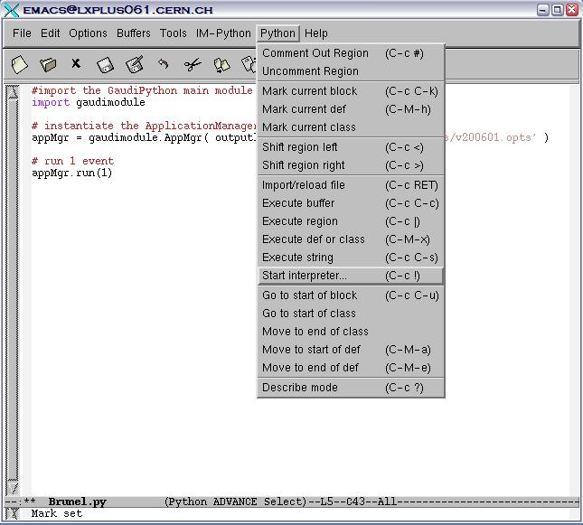
Python interpreter inside Emacs (1/2)
Neat way of
editing and running
in the same environment
Start a Python prompt
directly from within Emacs

Slide 11
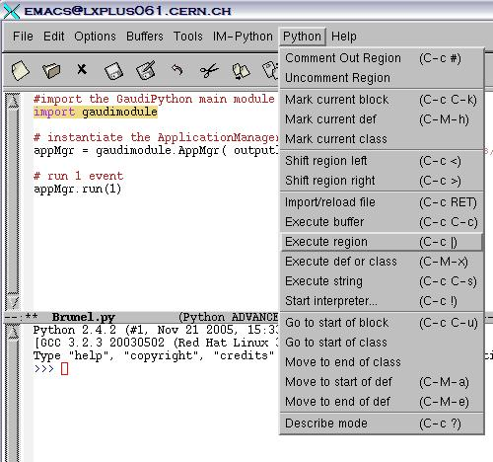
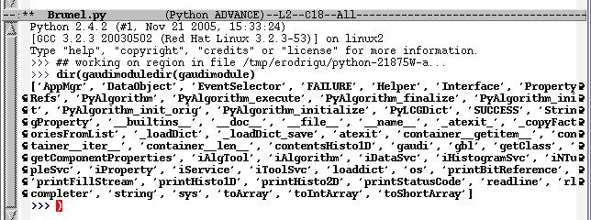
Python interpreter inside Emacs (2/2)
Code in the file can be highlighted and run piece-by-piece
Checking what
gaudimodule
contains

Slide 12
Common Applications
with GaudiPython

Slide 13
Reading a Gaudi file
>>> import gaudimodule
>>> appMgr = gaudimodule.AppMgr( outputlevel=3,
joboptions=‘$EVENTSYSROOT/options/PoolDicts.opts' )
>>> SEL = appMgr.evtSel()
>>> SEL.open( ‘PFN:rfio:/castor/cern.ch/user/c/cattanem/Boole/v11r5/0601-11144100.digi' )
>>> appMgr.run( 1 )
>>> EVT = appMgr.evtSvc()
>>> EVT.dump()
Minimum required
to read a file
/Event
/Event/Gen
/Event/MC
/Event/MC/Header
# some lines skipped ...
/Event/Link/Rec
/Event/Link/Rec/Track
/Event/Link/Rec/Track/Forward
/Event/Link/Rec/Track/RZVelo
/Event/Link/Rec/Track/Velo
# some lines skipped ...
/Event/Rec
/Event/Rec/Header
/Event/Rec/Status
/Event/Rec/Track
/Event/Rec/Track/Forward
/Event/Rec/Track/RZVelo
/Event/Rec/Track/Velo
# some lines skipped ...
Reading only needs
dictionaries
OUTPUT OF EVT.dump()
Content of the TES
(not all content is shown by default …)

Slide 14
Running a Gaudi Application
Example: to run Brunel
>>> import gaudimodule
>>> appMgr = gaudimodule.AppMgr( outputlevel=3, joboptions=‘../options/v200601.opts' )
>>> appMgr.run( 1 )
# feel like having a look at the TES?
>>> EVT = appMgr.evtSvc()
>>> EVT.dump()
Making use of interactivity …
>>> SEL = appMgr.evtSel()
>>> dir(SEL)
['__class__', '__delattr__', '__dict__', '__doc__', '__getattr__', '__getattribute__', '__hash__', '__init__', '__module__', '__new__', '__reduce__', '__reduce_ex__', '__repr__', '__setattr__', '__str__', '__weakref__', '_ip', '_isvc', '_name', '_optsvc', '_svcloc', 'finalize', 'g', 'getInterface', 'initialize', 'isnumber', 'isvector', 'name', 'open', 'properties', 'reinitialize', 'retrieveInterface', 'rewind', 'typecnv']
# say you need more printout of the algorithms/tools names …
>>> MSG = appMgr.service( 'MessageSvc‘ )
>>> MSG.Format = "% F%60W%S%7W%R%T %0W%M";
>>> SEL.rewind()
# off you go again …
>>> appMgr.run( 1 )
Just one possibility …

Slide 15
Retrieving objects from the TES
From now on let us assume we’ve always run at least 1 event …
>>> import gaudimodule
>>> appMgr = gaudimodule.AppMgr( outputlevel=3, joboptions=‘../options/v200601.opts' )
>>> appMgr.run( 1 )
>>> EVT = appMgr.evtSvc()
One might need to load some dictionaries for inspecting objects
appMgr.loaddict( ‘MCEventDict’ )
appMgr.loaddict( ‘TrackEventDict’ )
This will becone unnecessary
in the future …
>>> tracks = EVT[ ‘Rec/Track/Forward’ ]
>>> print tracks.size()
11
>>> mcps = EVT[ ‘MC/Particles’ ]
>>> for mcp im mcps:
>>> print mcp.particleID.pid(), mcp.p()
Looping over the container

Slide 16
Using the Event Model Classes (1/2)
Our classes are defined in the
LHCb namespace
>>> Track = gaudimodule.gbl.LHCb.Track
>>> Track
<class '__main__.LHCb::Track'>
>>> defaultTrack = gaudimodule.gbl.LHCb.Track()
>>> defaultTrack
{ chi2PerDoF : 0
nDoF : 0 flags : 0
lhcbIDs :
states :
measurements :
nodes :
}
Get hold of the class definition
Track class instantiation
Track data members
appMgr.loaddict( ‘TrackFitEventDict’ )
appMgr.loaddict( ‘LHCbKernelDict’ )
>>> aLineTraj = gaudimodule.gbl.LHCb.LineTraj()
>>> aStateTraj = gaudimodule.gbl.LHCb.StateTraj()
>>> otMeas = gaudimodule.gbl.LHCb.OTMeasurement()

Slide 17
Using the Event Model Classes (2/2)
Playing with the enums …
>>> State = gaudimodule.gbl.LHCb.State
>>> State.LocationUnknown
0
>>> State.AtT
5
>>> State.BegRich2
8
>>> Measurement = gaudimodule.gbl.LHCb.Measurement
>>> Measurement.Unknown
0
>>> Measurement.VeloR
1
>>> Measurement.TT
3
Neat way of using the enums:
As close as possible to the C++ syntax
e.g.: State::AtT -> State.AtT

Slide 18
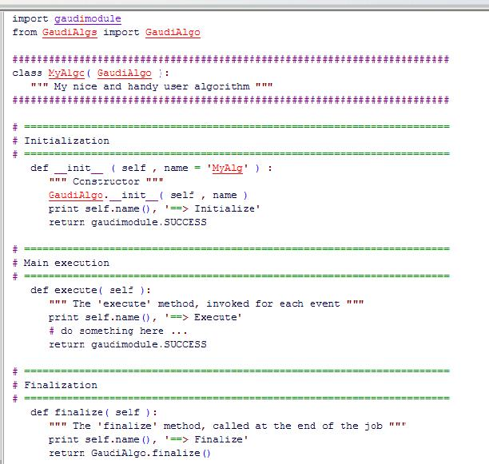
User-defined Algorithm
Modules from GaudPython
My class definition
Algorithm’s main methods

Slide 19
Tracking in Python
LHCb Note 2006-014 for further explanations

Slide 20
Tracking Classes (1/3)
If you ever thought the Track class cannot answer many questions …
>>> track = tracks[0]
>>> dir(track)
['AlreadyUsed', 'Backward', 'CnvForward', 'CnvKsTrack', 'CnvMatch', 'CnvSeed', 'CnvVelo', 'CnvVeloBack', 'CnvVeloTT', 'Downstream', 'FitFailed', 'FitUnknown', 'Fitted', 'HistoryUnknown', 'IPSelected', 'Invalid', 'IsA', 'Kalman', 'Long', 'PIDSelected', 'PatForward', 'PatKShort', 'PatRecIDs', 'PatRecMeas', 'PatVelo', 'PatVeloTT', 'ShowMembers', 'StatusUnknown', 'Streamer', 'StreamerNVirtual', 'TrackIdealPR', 'TrackKShort', 'TrackMatching', 'TrackSeeding', 'TrackVeloTT', 'TrgForward', 'TsaTrack', 'Ttrack', 'TypeUnknown', 'Unique', 'Upstream', 'Velo', 'VeloR', '__class__', '__delattr__',
# a few lines skipped ...
'__weakref__', 'addToAncestors', 'addToLhcbIDs', 'addToMeasurements', 'addToNodes', 'addToStates', 'ancestors', 'charge', 'checkFlag', 'checkHistory', 'checkHistoryFit', 'checkStatus', 'checkType', 'chi2', 'chi2PerDoF', 'clID', 'classID', 'clearAncestors', 'clearStates', 'clone', 'cloneWithKey', 'closestState', 'copy', 'fillStream', 'firstState', 'flag', 'flags', 'hasKey', 'hasStateAt', 'history', 'historyFit', 'index', 'isMeasurementOnTrack', 'isOnTrack', 'key', 'lhcbIDs', 'measurement', 'measurements', 'momentum', 'nDoF', 'nLHCbIDs', 'nMeasurements', 'nMeasurementsRemoved', 'nStates', 'nodes', 'p', 'parent', 'posMomCovariance', 'position', 'positionAndMomentum', 'pt', 'removeFromAncestors', 'removeFromLhcbIDs', 'removeFromMeasurements', 'removeFromNodes', 'removeFromStates', 'reset', 'serialize', 'setChi2PerDoF', 'setFlag', 'setFlags', 'setHistory', 'setHistoryFit', 'setLhcbIDs', 'setNDoF', 'setParent', 'setSpecific', 'setStatus', 'setType', 'slopes', 'specific', 'stateAt', 'states', 'status', 'type']

Slide 21
Tracking Classes (2/3)
Operations on the enums
>>> track.checkType( Track.Long ), track.type() == Track.Long
(1, True)
>>> track.checkHistory( Track.PatForward )
1
>>> track.checkStatus( Track.Fitted )
0
Basic properties
>>> track.charge()
1
>>> track.nDoF()
12
Track contents
>>> track.nStates()
2L
>>> state = track.states()[0]
>>> state.x(), state.y(), state.z()
(16.987653188753605, 0.0, 397.76935188731028)

Slide 22
Tracking Classes (3/3)
The Track can also be modified …
>>> newtrack = track.clone()
>>> newtrack.setFlag( Track.Clone, True )
>>> newtrack.checkFlag( Track.Clone )
1
What’s on the track?
>>> print track.nLHCbIDs()
32
>>> print track.nMeasurements()
0
>>> ids = track.lhcbIDs()
>>> ids
<ROOT.vector<LHCb::LHCbID> object at 0xf4eab24>

Slide 23
Extrapolators (1/2)
# Helper dict. of package with gtracktools module
appMgr.loaddict( ‘TrackPythonDict’ )
>>> from gtracktools import setToolSvc, extrapolator
>>> setToolSvc( appMgr )
>>> linprop = extrapolator( 'TrackLinearExtrapolator' )
>>> dir(linprop)
# some lines skipped ...
'__setattr__', '__str__', '__weakref__', 'addRef', 'finalize',
'initialize', 'interfaceID', 'momentum', 'name', 'p', 'parent',
'position', 'positionAndMomentum', 'propagate', 'pt',
'queryInterface', 'release', 'slopes', 'transportMatrix', 'type']
>>>
>>> help(linprop.propagate)
# one gets several lines of documentation
Needs to be called only once
(may become unnecessary …)
Get hold of the Linear extrapolator

Slide 24
Extrapolators (2/2)
# get hold of the Track to be extrapolated
>>> track = tracks[3]
# instantiate a State, to retrieve the result of the extrapolation
>>> state = gaudimodule.gbl.LHCb.State()
>>> state.x(), state.y(), state.z()
(0.0, 0.0, 0.0)
# instantiate the parabolic extrapolator
>>> parprop = extrapolator( 'TrackParabolicExtrapolator' )
# define the z-position to extrapolate to
>>> znew = 100.
>>> parprop.propagate( track, znew, state )
SUCCESS
>>> state.x(), state.y(), state.z()
(-5.859069220236659, -1.5738179596044015, 100.0)
# "state" variable contains some random State
>>> state.x(), state.y(), state.z()
(491.95847296136429, -39.394353509484759, 9520.0)
>>> newstate = state.clone()
>>> linprop.propagate( newstate, 5000. )
SUCCESS
>>> newstate.x(), newstate.y(), newstate.z()
(72.562676254077573, -21.114433639356392, 5000.0)

Slide 25
Checking on Clone Tracks
>>> from gtracktools import cloneFinder
>>> CLONEFINDER = cloneFinder( 'TrackCloneFinder' )
GETTING HOLD OF THE CLONES FINDER
>>> track0 = tracks[0]
>>> track1 = tracks[1]
>>> TrackCloneFinder.areClones( track0, track1 ) == True
False
>>> track1 = track0.clone()
>>> TrackCloneFinder.areClones( track0, track1 ) == True
True
Pick up some 2 tracks
Are they clones?

Slide 26
Fitting a Tracking "from A to Z"
>>> from gtracktools import fitter
>>> MASTERFITTER = fitter( 'TrackMasterFitter' )
# one gets some printout at this level ...
GETTING HOLD OF THE MASTER FITTER
# Fitting tracks with the default options cannot get simpler.
# The "complete job", i.e. fitting and setting of the appropriate flags, only takes a few lines:
>>> track = tracks[0]
>>> sc = MASTERFITTER.fit( track )
>>> if sc == gaudimodule.SUCCESS:
... track.setStatus( Track.Fitted )
... else:
... track.setStatus( Track.FitFailed )
... track.setFlag( Track.Invalid, True )
Pick up some track and fit it
Done! Set Status flag

Slide 27
Linker Tables of Tracks (1/2)
Finding the Linker table Track - MCParticle
>>> location = 'Rec/Track/Velo'
>>> tracks = EVT[ location ]
>>> from eventassoc import linkedTo
>>> Track = gaudimodule.gbl.LHCb.Track
>>> MCParticle = gaudimodule.gbl.LHCb.MCParticle
>>> LT = linkedTo( MCParticle, Track, location )
>>> LT
<ROOT.LinkedTo<LHCb::MCParticle,LHCb::Track> object at 0xf485460>
>>> LT.notFound() == False
True
Get some tracks (e.g. VELO tracks)
Class definitions
Retrieve Linker table
>>> track = tracks[7]
>>> mcp = LT.first(track)
>>> mcp.key()
849
>>> mcp
{ momentum : (-673.62,-416.03,11761.6,11789)
particleID : { pid : 211
}
}
>>> mcp = LT.next()
>>> mcp == None
True
Get link with heighest weight
Get next linked MCParticle, if any

Slide 28
Linker Tables of Tracks (2/2)
Going « back and forth» with links …
>>> from eventassoc import linkedFrom
>>> LF = linkedFrom(Track,MCParticle,location)
>>> LF
<ROOT.LinkedFrom<LHCb::Track,LHCb::MCParticle> object at 0xf4d6210>
>>> LF.notFound() == False
True
>>> track.key()
7
>>> mcp = LT.first(track)
>>> mcp.key()
849
>>> trk = LF.first(mcp)
>>> trk.key()
7
With the looks of the Associators …
>>> range = LT.range(track)
>>> range
<ROOT.vector<LHCb::MCParticle*> object at 0xfe27e90>
>>> range.size()
1L
>>> mcp = range[0]
>>> mcp.key()
849

Slide 29
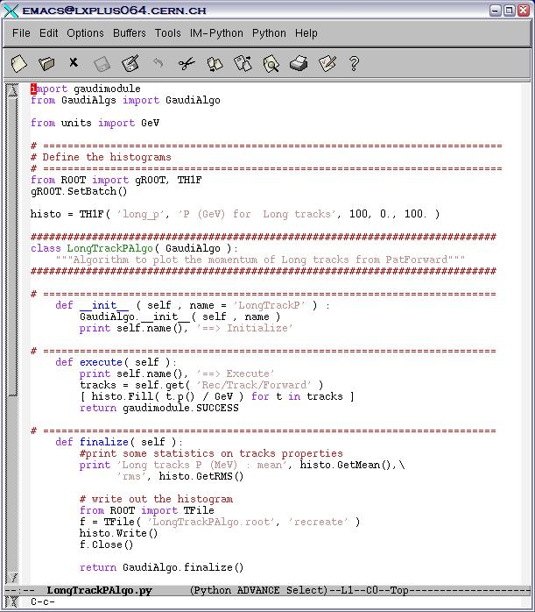
Using what is available …
Python version of GaudiAlgorithm
Standard HEP units
Algorithm definition
Algorithm’s main methods
Save the ROOT histo to a file

Slide 30
Second part of the file
All of this will execute if the whole file is run as
python -i myJob.py with this bit:
>>> appMgr = gaudimodule.AppMgr( outputlevel=3, joboptions='../options/v200601.opts' )
>>> appMgr.loaddict( 'TrackEventDict' )
>>> appMgr.loaddict( 'TrackPythonDict' )
>>> EVT = appMgr.evtSvc()
>>> appMgr.addAlgorithm( LongTrackPAlgo( 'LongTrackP' ) )
>>> appMgr.run( 250 )
>>> from ROOT import TCanvas
>>> histo.Draw()
# not necessary unless you really want to finish everything:
#appMgr.finalize()
# run some more events!
>>> appMgr.run( 100 )
# continue playing interactively …
# with the « -i » option the user gets back control on the prompt …
>>> f = ROOT.TFile( LongTrackPAlgo.root’, 'READ' )
# play with the contents …

Slide 31
Playing with ROOT & RooFit

Slide 32
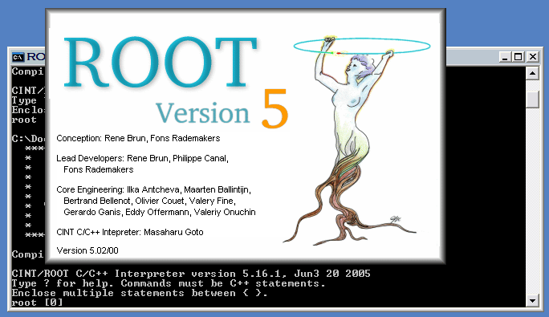
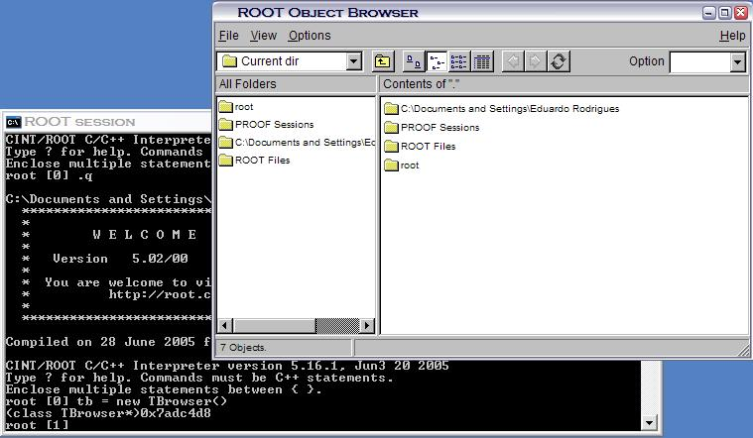
ROOT from DOS
Instantiation of the TBrowser

Slide 33
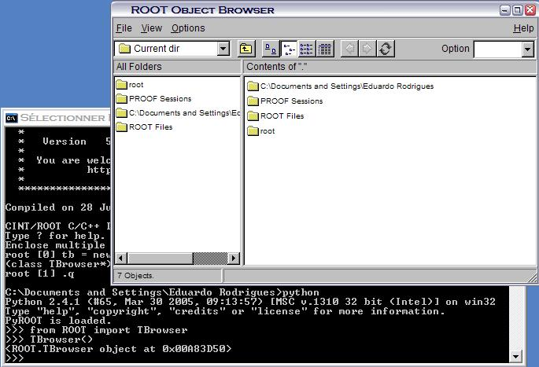
ROOT from the Python Prompt
Instantiation of the TBrowser from the Python prompt

Slide 34
Using ROOT
Defining some looks!
from ROOT import TStyle, TF1, TFile, TCanvas
def rootSettings():
global myStyle
myStyle = ROOT.TStyle( 'myStyle', 'My personal ROOT style' )
myStyle.SetCanvasColor( 0 )
myStyle.SetPadColor( 0 )
myStyle.SetOptStat( 111111 )
myStyle.SetOptFit( 1111 )
ROOT.gROOT.SetStyle( 'myStyle' )
ROOT.gROOT.ForceStyle()
Defining a user-made fitting function
def fit_histo( h ):
max = h.GetMaximum()
doubleGaussian = ROOT.TF1( "Double Gaussian", "gaus(0) + gaus(3)" )
doubleGaussian.SetParameters( max, h.GetMean(), h.GetRMS(), max/100., h.GetMean(), h.GetRMS()*10. )
h.Fit( doubleGaussian )
return doubleGaussian.GetParameter(2) # RMS of core Gaussian

